Slide 1


Coderstrust Academy
Group 9

Slide 2

What is our course about?
Business
Budgeting
P&L, balance sheet and Cash Flow statement
Invoices
Minimum hourly wage

Slide 3
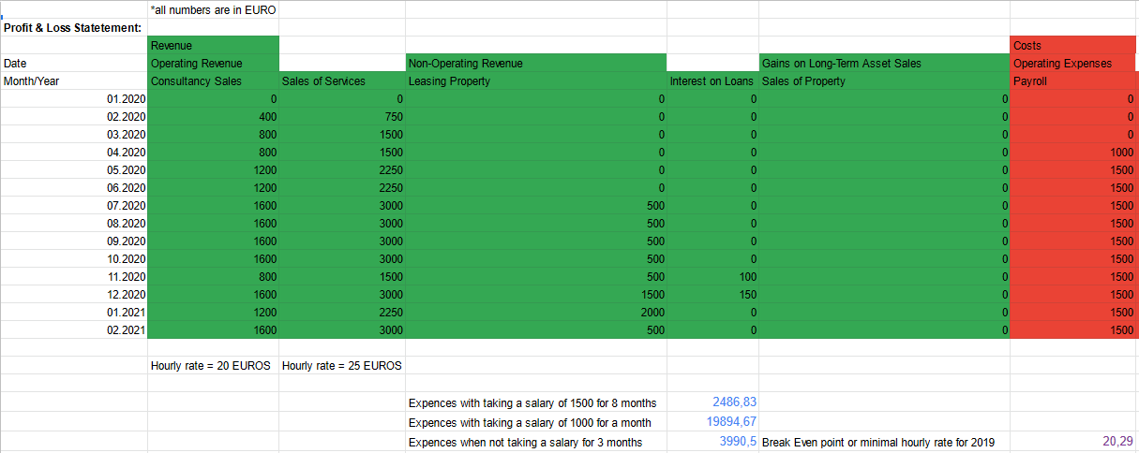

In house example for Excel sheet
The example that is given to the students for understanding of what is important for freelancers while making their budget

Slide 4
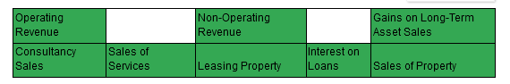
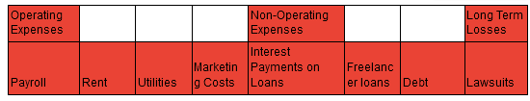
Profit and Loss Statment
Revenue
Freelancer revenues explained in our course:
Costs
Freelancer costs that we describe in our course:

Slide 5
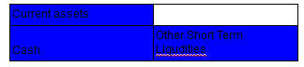
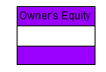
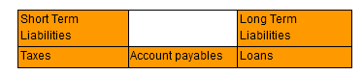
Balance Sheet
Assets
Freelancers assets that are described in our ourse:
Liabilities
Liabilities that are described in our course:
Owners Equity
The ending result of assets- liabilities:

Slide 6
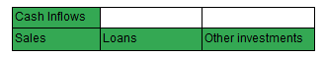
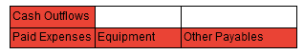
Cashflow satement
Cash Inflows
All the positive actions affecting the cash of the freelancer:
Cash outflows
The spendings of the freelancer:
Beginning cash balance
The start of the month cash balance, it is equal to the previous months ending cash balance.
Ending cash balance
The end of the month result, which is the inflows are added and the outflows are subtracted from the beginning cash balance.

Slide 7
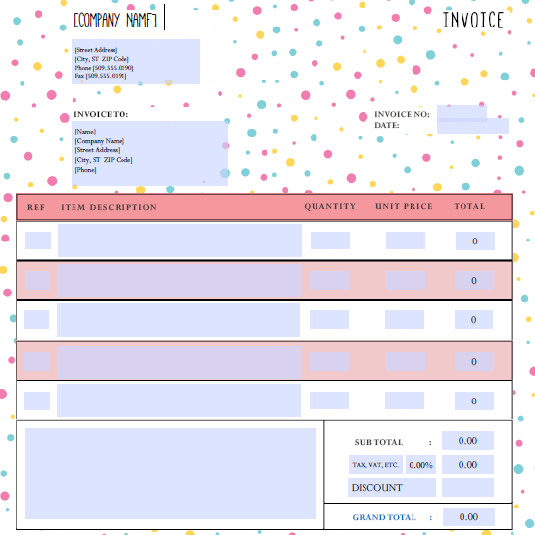

Invoice
An example on the invoice template, that we advise to use

Slide 8
Negotiations
Create the relationship
Avoid hostility
Weigh your claim against the relationship
Create value
Design the right forum
Find common ground

Slide 9
What is our course about?
Project Management
Reasons for the project
The goal of the project
The shareholders and customers
Identification of risks
Advantages of the project
Budgeting
Time management

Slide 10
Our example for Project Charter
Project Name: “Creating a Multifunctional Database for Coderstrust’
Project Description: A 2 week project for creation of a multifunctional database.
Business Case: Supports our company wide goals of:
1. Creating a more precise and informative database
2. Giving Coderstrust a bigger advantage and establishing it as a leading online courses platform
Project Deliverables:
1. A multifunctional database, with better data storage
2. UML diagrams for relative model and an entity relationship diagram
3. A separation quiz that gives information about the new coming students abilities

Slide 11
Our example for Project Charter
Project Benefits:
1. Creation of a better online platform than the competitors
2. Easier grouping of data and etter classification of students
3. Easier access for Coderstrust employees
Project Risks
1. Technical difficulties with the website, rendering it useless in the span of 2 weeks
2. Adjustments of the employees to the new database will take time
Project Budget:
Not to exceed $5000
Project Milestones:
Finishing of explanatory diagrams: March 18, 2021
Creation of the database: March 22, 2021
Implementation and bug testing: March 26, 2020
Project Team Members: 4
Project Manager: Casper Wagner Blomgren
Designer: Casper Wagner Blomgren
Coder 1: Denis Petrov
Coder 2: Mikael Lau Slot
Email Marketing Coordinator: Magnus Brønd Rasmussen

Slide 12
Work Organisation
Projekt og tidsplan
Prioter delene i projektet
Sørg for at holde deadlines
Benyt tilknyttede software
Kommunikation og fremtidsudsigter
Hold øje mod proces samt vær fleksibel for ændringer

Slide 13
Online programs
Github
Trello
Makes working apart easier

Slide 14
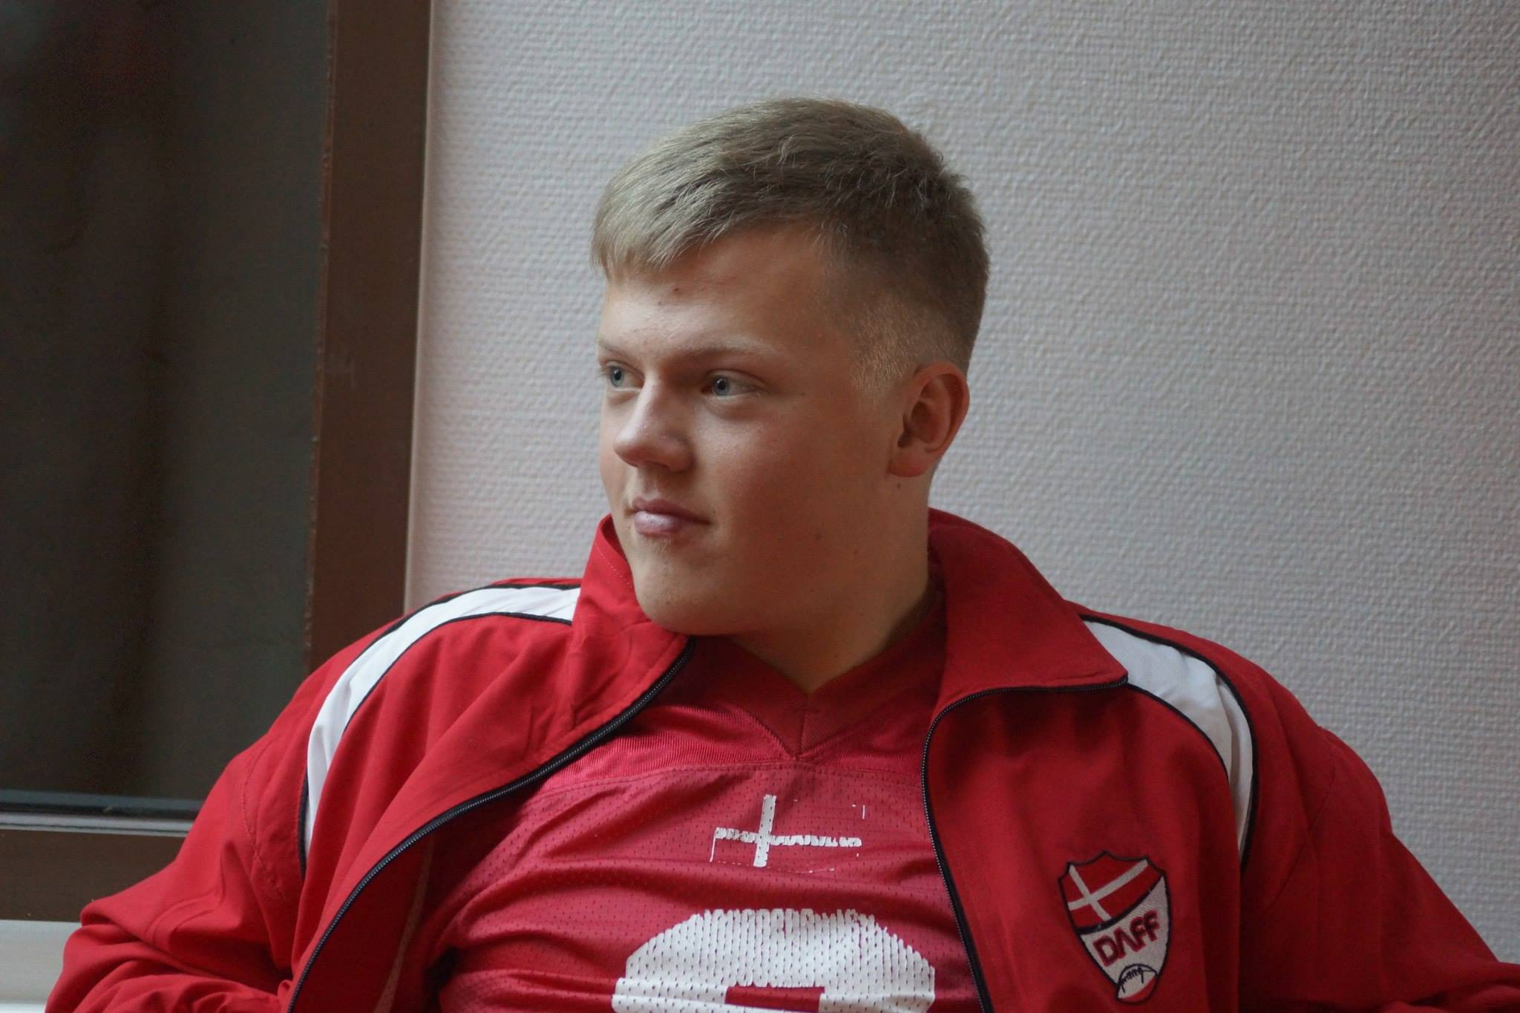
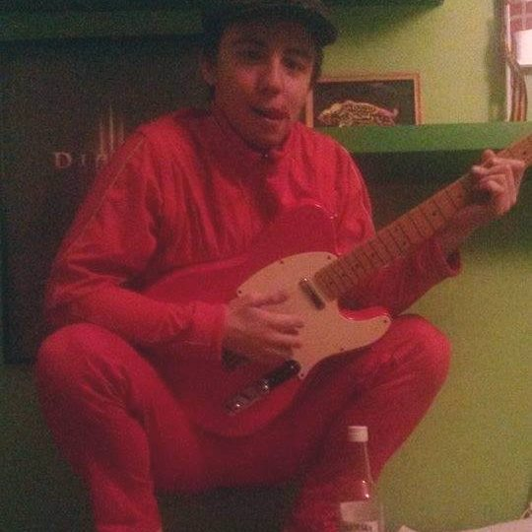
Our Team
Casper Wagner Blomgren
Denis Petrov

Slide 15
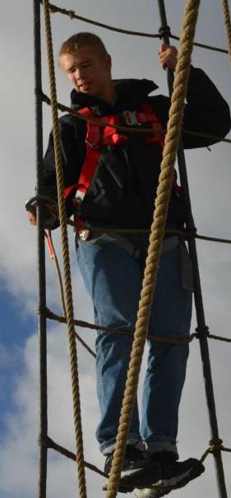

Our Team
Magnus Brønd Rasmussen
Mikael Slot

